Slide 1
Data and Analytics that In-House Counsel are Watching….
….And How To Drive Revenue
Patrick Fuller
Director of Legal Analytics
ELM Solutions
Legal Analytics

Slide 2
How did we get to this point?

Slide 3
Revenue Disparity
104%

Slide 4
Am Law 200 Revenue Share

Slide 5
Revenue / RPL-PPEP Rank Disparity Metric
Disparity Score = (Revenue Rank – RPL Rank) + (Revenue Rank – PPEP Rank)
Bottom 20 Firms
  Average score: -180.9
  Average Am Law Rank: 49
  Average Firm Size: 1652
Top 20 Firms
  Average score: 182.2
  Average Am Law Rank: 157
  Average Firm Size: 183

Slide 6
Am Law 200 Revenue, 2003 - Present
Sources: Copyright 2003-2015, Deductive Intelligence Group, LLC and American Lawyer Media, Inc.

Slide 7
The Numbers: Am Law 200 Comparison
Sources: Copyright 2003-2015, Deductive Intelligence Group, LLC, American Lawyer Media, Inc., & Statista.com

Slide 8
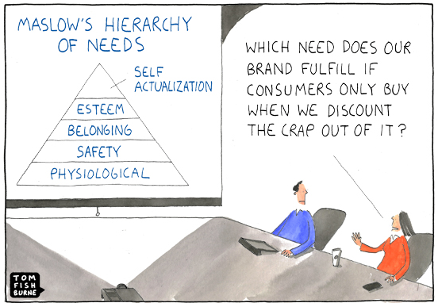
Benchmarking

Slide 9
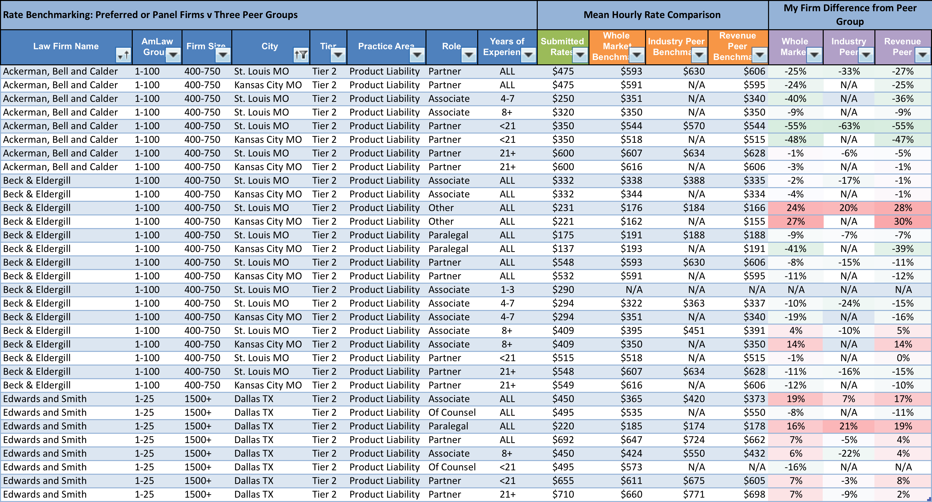
Benchmarking – Corporate Legal Departments

Slide 10
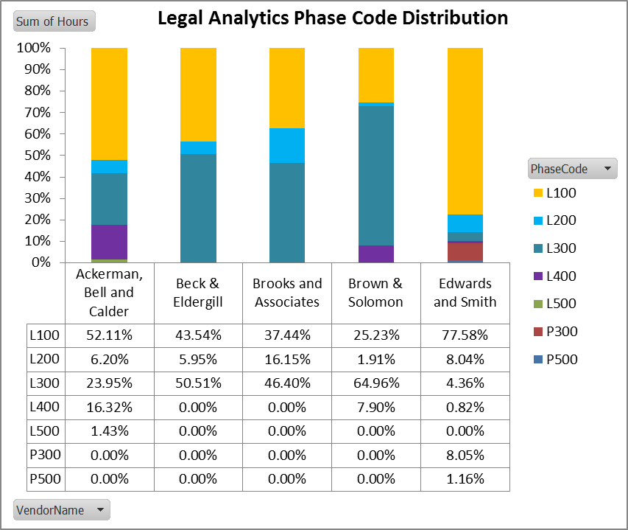
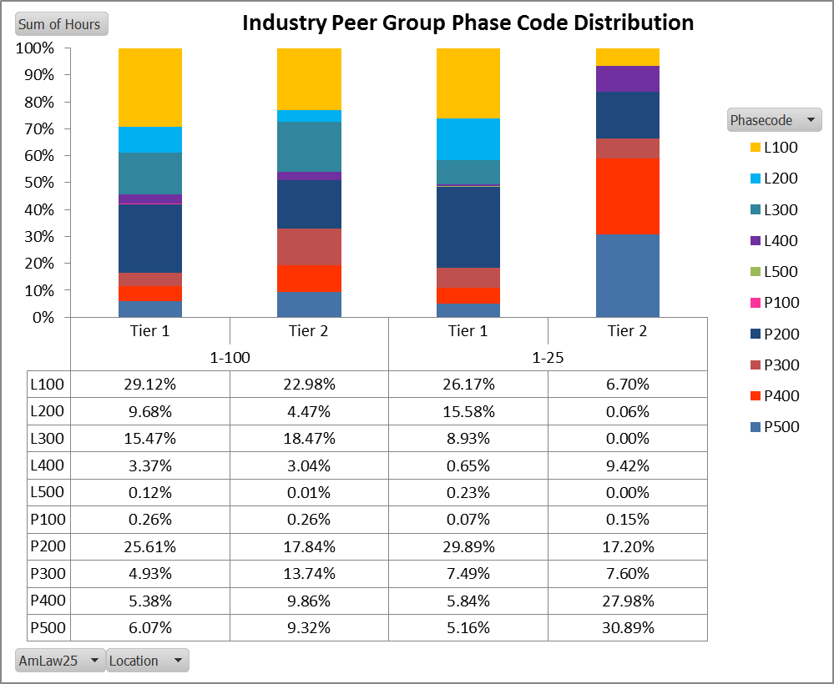
Benchmarking of Phase Execution Amongst Firms
The Client’s top 5 outside counsel firms – Product Liability
Product Liability Benchmark data from The LegalVIEW Database, showing both Tier 1 & 2 markets for Am Law 1-25 & 1-100 groupings.
This is an example of benchmarking Phase execution & spend concentration amongst firms for a selected practice area(s), market, and/or Industry.

Slide 11
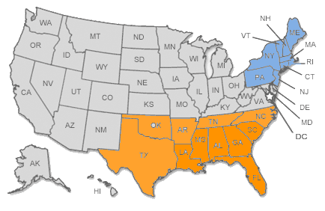
Rates vs. Region
Litigation
Timekeeper | AmLaw 100 | AmLaw 200 | Unranked Firms
Partners | $685 | $486 | $335
Associates | $465 | $304 | $241
General Commercial Litigation Matters
All Industries
750-1100 Billed Hours
Timekeeper | AmLaw 100 | AmLaw 200 | Unranked Firms
Partners | $566 | $371 | $302
Associates | $339 | $234 | $201
confidential

Slide 12
Rates vs. Region
Non-Litigation
Timekeeper | AmLaw 100 | AmLaw 200 | Unranked Firms
Partners | $840 | $552 | $561
Associates | $500 | $342 | $391
General Corporate Matters
All Industries
750-1100 Billed Hours
Timekeeper | AmLaw 100 | AmLaw 200 | Unranked Firms
Partners | $604 | $412 | $354
Associates | $356 | $247 | $226
confidential

Slide 13
Metrics

Slide 14
What Is Measured
A Sampling of Metrics Management
Legal spend month over month
Amount of Invoices Flagged vs. Submitted by Vendor
Matter spend by duration
Legal spend breakdown by practice area
Open to close ratio–month over month
Top matters by spend
Top vendors by spend
Legal Department budget to actual
Billed rate by role–year over year
Practice area blended rate–year over year
Total spend by vendor
Rate review & comparison
Top firms by evaluation
Ratio of low to high severity cases
% of matters with budget
% of matters with assessment
Avg Matter cost w/ budget vs. no budget
% of matters with status updates
% of matters handled via AFAs
AFA Savings By Initiative / Type / Vendor
AFA Adjustments By Vendor / Type / Practice
Firm staffing by Matter / Practice / TK
TK hours by phase
Average Role Rate vs. Average Billed Rate
Top Roles By Fee
Top Roles by % of Hours Billed
Top TK by Hours / Spend
TK Rates By Role By Vendor By Practice By Business Unit
Diversity % to Actual by Firm
Diversity % to Actual by Practice Area by Firm
Leverage to Actual by firm
Leverage to Actual by Firm by Practice Area
Diversity Allocation % by Firm
Diversity Allocation by TK Role by Firm by Matter by Exposure Amount
confidential

Slide 15
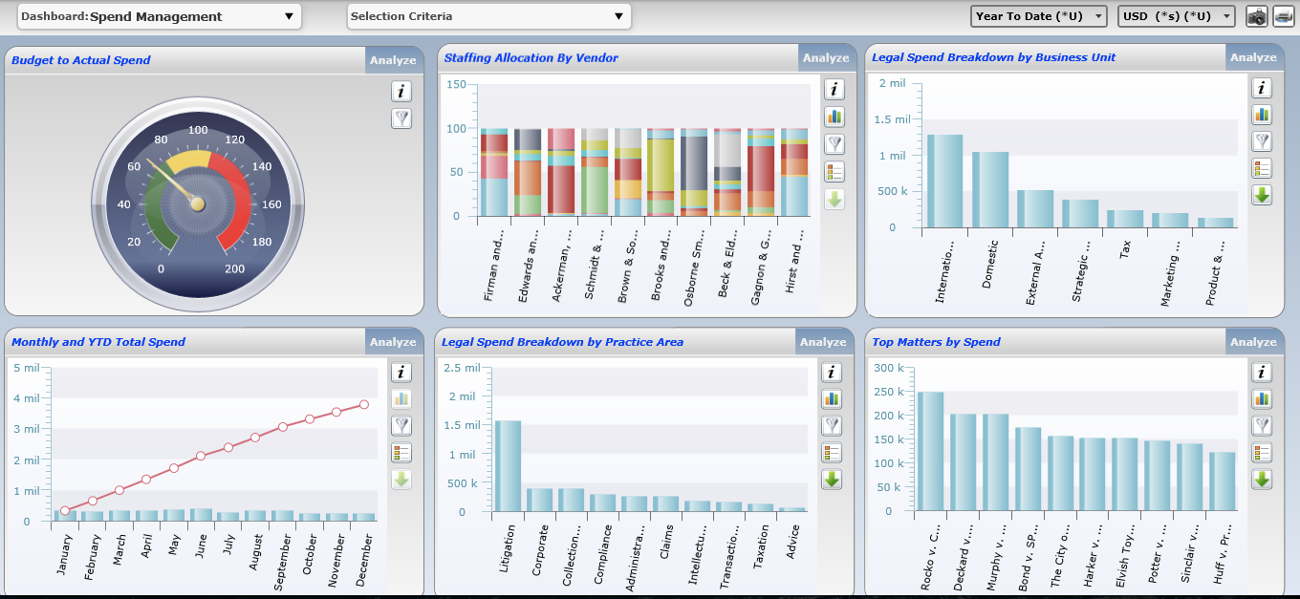
Dashboards
Sample Data. For Illustrative Purposes Only.

Slide 16
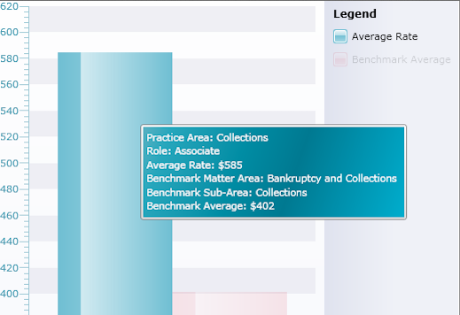
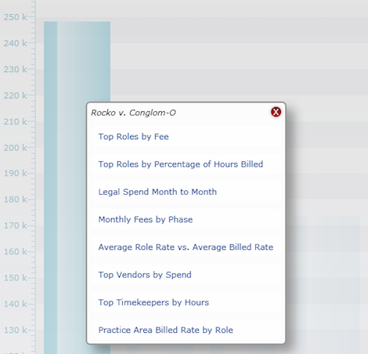
Interactive Dashboards
Legal Department Metrics
Sample Data. For Illustrative Purposes Only.

Slide 17
Assuming the excess (i.e. the number of entries exceeding 20% of all entries) upbilled entries overstate time by 15 minutes per entry, the fees generated by the excess entries are projected in the final column, “Estimated Upbilling Cost.”

Slide 19
Looking across all law firms, this report identifies those ten individuals who most often use identical language in two or more invoice line item entries to describe work performed.

Slide 20
Looking across all matters, this report identifies those ten individuals who bill the most fees for work performed over the weekend. It identifies the fees, hours and percent of hours billed for work performed on Saturdays and Sundays.

Slide 21
Block billing is the practice of including within one invoice line item entry, more than one type of task.
This practice should be disallowed for two principal reasons:
  The time spent per task is not displayed, making an evaluation the reasonableness of time spent per task impossible.
  Most often, the UTBMS Task Code applied is inaccurate relative to one more of the tasks described.

Slide 22
That percentage is calculated as the number of days in which more than 10 hours was billed (“10+ Hour Days of Service”), divided by the number of days billed (“Total Days of Service”).
Ten hour days are often justified, but certain timekeepers will sometimes include “hollow” or unproductive hours for the day, e.g. a paralegal who bills 12 hours for a trial day, during which day the paralegal is “on call” throughout the day, but is not actively working on trial tasks.
Only hours ABOVE the 10th hour per day are counted towards the “Cost of 10+ Daily Hours” figure.

Slide 23
Promoted Timekeepers – Task Analysis

Slide 24
Matter Level Reporting
Firm | Attorney | Role | Total Hours | Fees | Rate
Pearson Specter | Rachel Zane | Legal Assistant | 3528 | $1,129,088.00 | $320.00
Pearson Specter | Louis Litt | Partner | 3082 | $2,342,168.00 | $760.00
Pearson Specter | Harvey Specter | Partner | 2987 | $2,383,755.00 | $865.00
Pearson Specter | Mike Ross | Partner | 2983 | $2,341,498.00 | $785.00
Pearson Specter | Jessica Pearson | Partner | 2926 | $2,325,852.00 | $795.00
Kenner Bach | Arthur Edens | Partner | 2699 | $2,240,004.00 | $830.00
Kenner Bach | Bridget Klein | Paralegal | 2900 | $565,559.00 | $195.00
Kenner Bach | Barry Grissom | Partner | 2678 | $2,089,074.00 | $780.00
Infeld Daniels | Stanton Infeld | Partner | 2677 | $2,744,950.00 | $1,025.00
Infeld Daniels | Damien Karp | Partner | 2643 | $2,275,474.00 | $860.00
Top Ten Timekeepers by Hours Billed to XYZ Matter, 2014

Slide 25
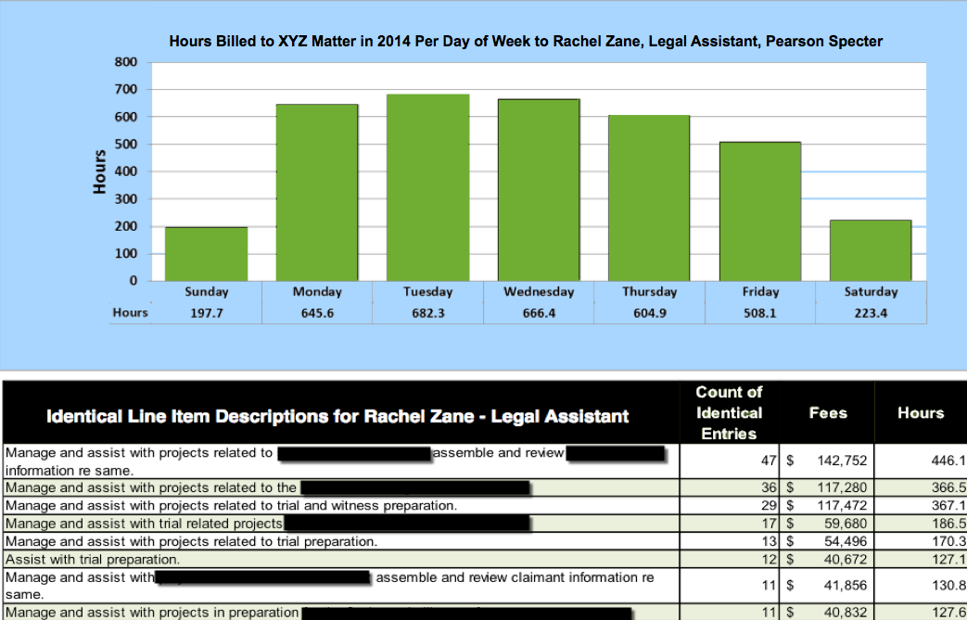
Analyses of Rachel Zane’s 2014 Billing Tendencies

Slide 26
End of Matter Evaluations

Slide 27
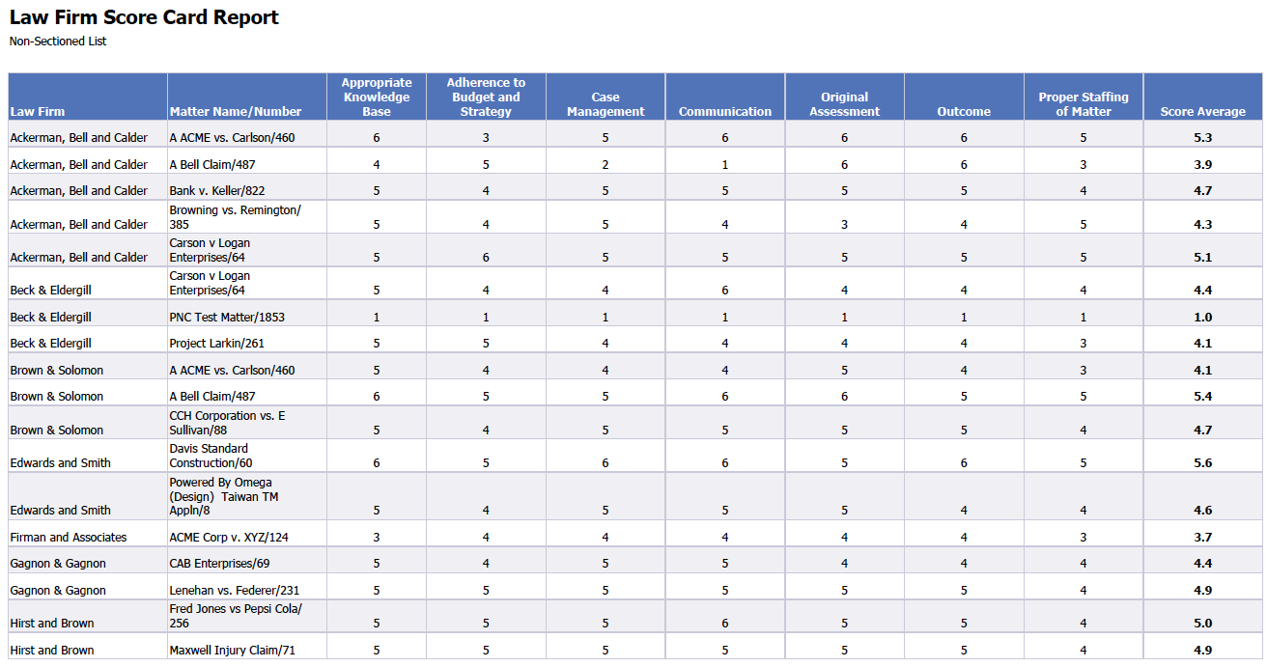
End of Matter Evaluations

Slide 28
Sample Evaluation Criteria
Quality of Legal Work
  Experience / Expertise
  Creative solutions to legal issues
  Achieves business goals / needs
Billing Practices
  Fees consistent with expectations
  Timely invoice submittal
  Billing guideline compliance
  Work product not excessive or overdone
  Flexible / creative billing arrangement
  Efficient staffing of matter
Timeliness of Service / Comm.
  Proactive communication of schedules, time, & fee estimates
Matter / Case Management
  Responsiveness to inquiries, calls, emails
  Timely updates to significant developments
  Adherence to agreed strategy
  Effective staffing of matter
  Organization & planning
Budget Adherence
  Effectively manages matter to a budget
  Accuracy of initial budget
  Frequency of budget updates
Effective Relationship Partner
  RP conducts quality control of invoices prior to submittal to company
  RP monitors appropriate staffing of the matters
  Proactive and effective communication regarding the matter
Would you hire firm / attorney again?

Slide 29
Law Firm Evaluations
Law Firm | # of Matters (All) | # of Matters (Open) | # of Matters (Closed) | # of Eval. | Latest Survey Date | Legal Expert | Eff. / Process Mgmt | Resp./ Comm. | Pred. Costs/ Budget. Skills | Results Deliver / Exec. | Understands Obj./ Expect. | Overall | % Possibility of using Firm Again
 |  |  |  |  |  | (1=Poor to 5=Excellent)
Law Firm A | 360 | 330 | 30 | 3 | 3/27/13 | 2.3 | 2.0 | 2.7 | 3.0 | 1.3 | 1.7 | 2.2 | 67%
Law Firm B | 174 | 145 | 29 | 3 | 12/13/12 | 3.3 | 3.0 | 3.3 | 3.3 | 3.0 | 3.3 | 3.2 | 100%
Law Firm C | 107 | 60 | 51 | 7 | 12/13/12 | 3.0 | 3.0 | 3.0 | 3.0 | 3.0 | 3.0 | 3.0 | 100%
Law Firm D | 12 | 9 | 3 | 1 | 5/21/13 | 3.0 | 3.0 | 3.0 | 3.0 | 3.0 | 3.0 | 3.0 | 100%
Law Firm E | 13 | 4 | 9 | 1 | 5/22/13 | 4.0 | 4.0 | 4.0 | 3.0 | 3.0 | 4.0 | 3.7 | 0%
Law Firm F | 233 | 155 | 82 | 3 | 5/22/13 | 2.3 | 2.7 | 3.0 | 3.0 | 2.7 | 3.7 | 2.9 | 33%
Law Firm G | 184 | 169 | 15 | 3 | 4/9/13 | 4.0 | 5.0 | 5.0 | 4.7 | 3.0 | 4.3 | 4.3 | 100%
Law Firm H | 31 | 7 | 24 | 2 | 5/22/13 | 3.0 | 2.5 | 3.0 | 2.5 | 3.0 | 2.5 | 2.8 | 50%
Law Firm I | 60 | 26 | 35 | 1 | 5/22/13 | 3.0 | 3.0 | 3.0 | 3.0 | 3.0 | 3.0 | 3.0 | 100%

Slide 30
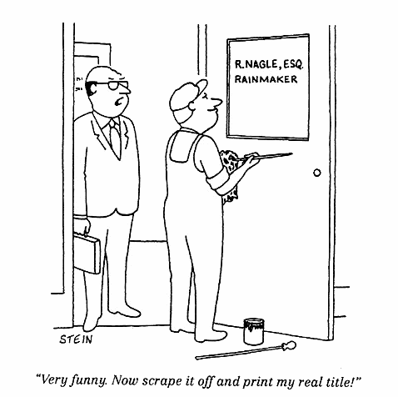
Core Elements of Business Development

Slide 31
Three Types of BD Demand
Known Demand
Reactive Demand
Unknown Demand

Slide 32
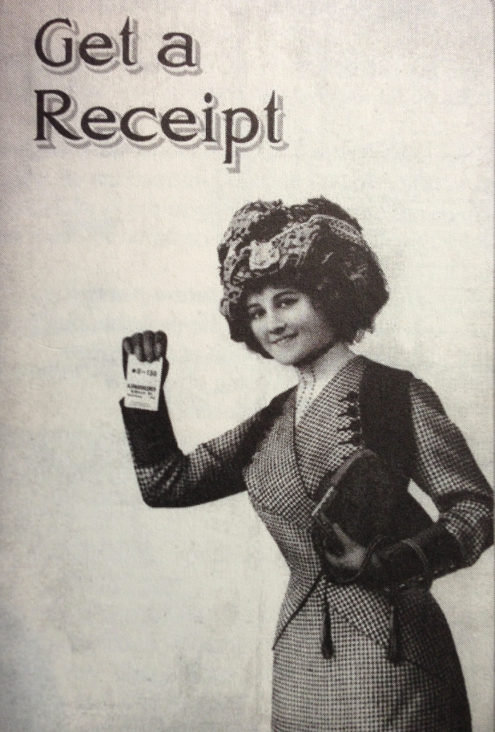

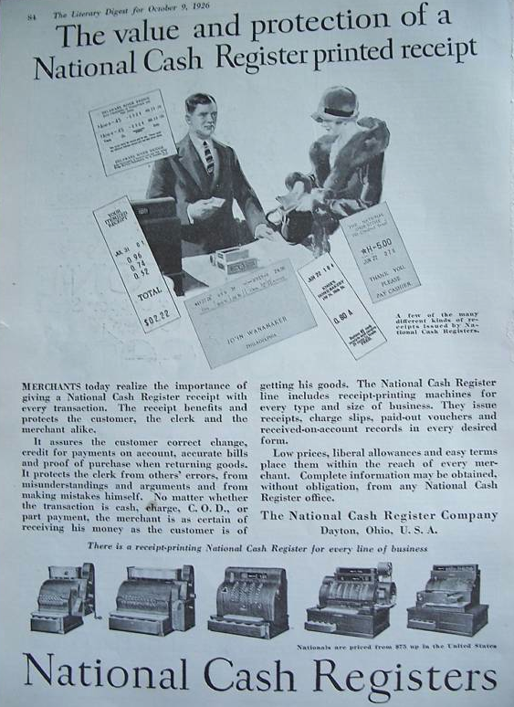
Modern Demand Creation
Modern Day Blue Ocean Strategy
Focused on profitability, not cost
Also referred to prospects as “probable purchasers”
Continued to develop competitive edge

Slide 33
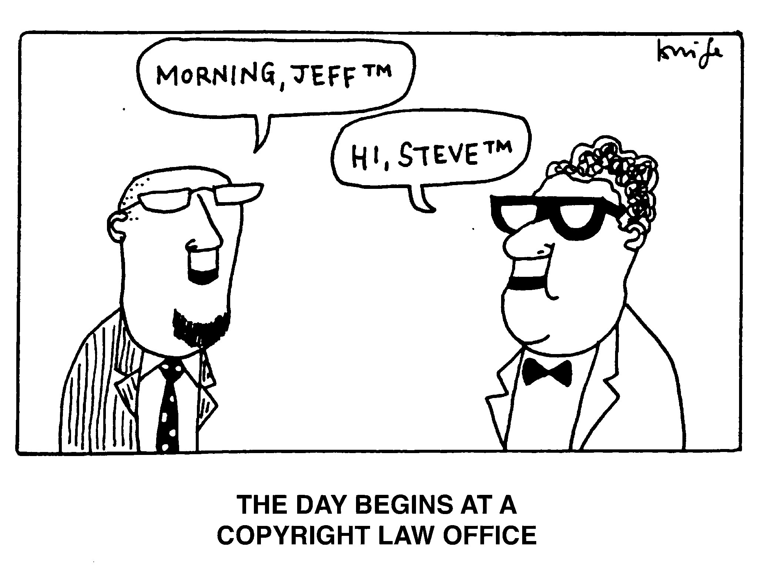
….It’s Who Knows You
It’s Not Who You Know….

Slide 34
Create Visibility
The address book, rolodex, contacts folder, etc. are all finite.
Thought Leadership is a key way to create differentiation from competitors
Writing & Speaking helps to underscore expertise
Use visibility strategies – through writing, speaking, etc. - to create demand
Shorten The BD Process

Slide 35
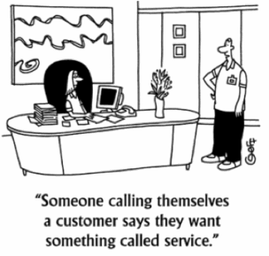
…As Fast As Your Client’s World Is Changing?
Are You Learning….

Slide 36
Complexity
The client’s environment is changing daily
The Business is becoming more involved in CLD Operations
The role of CLO / GC continues to broaden
  Greater increase in corporate governance, risk management, and key stakeholders
The best leaders and innovators have the widest field of vision
The most successful learners are not loners
“We hire attorneys who know our business and our industry”
Client & Industry Teams are driving this focus in many firms

Slide 37
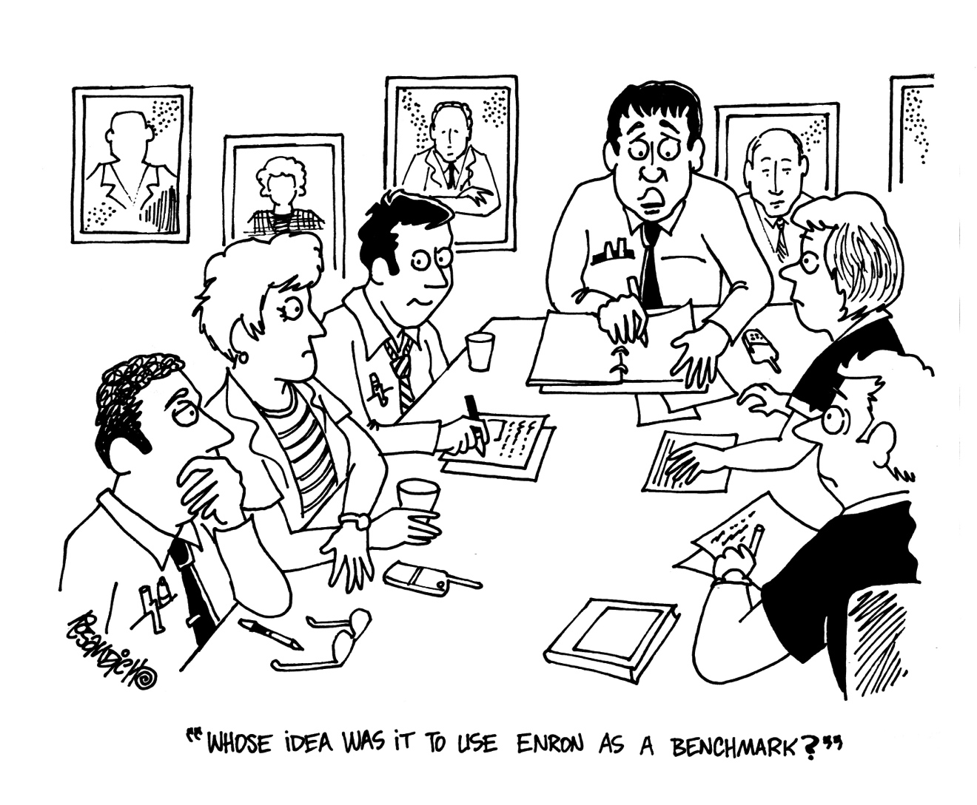
…And Justified By Logic
People’s Buying Decisions Are Driven By Emotion….

Slide 38
Driving Buying Decisions
Two data sources that are unique to every firm
  Emotion: Relationships
  Logic: Experience
Corporations are branded by Advertising – Law Firms are branded by Experience
Why Experience is critical for smaller firms…
  Are you the “most” of anything?
Let your experience – and success – work for you.
What’s more important initially – to be liked or trusted?
People buy from people they like, but….
  Belief drives passion, and mediocrity is derived more from lack of belief rather than lack of skill
Hunters v. Farmers?
Notes:
Trusted Advisors are friends

Slide 39
Guiding The Pitch
I
Inform
Guiding Question:
What do we want the prospect to know?
D
Differentiate
Guiding Question:
What do we offer that is unique from our competitors?
E
Emotion
Guiding Question:
What do we want the prospect to feel?
A
Action
Guiding Question:
What do we want the prospect to do?

Slide 40
How Can Firms Leverage This Intelligence?

Slide 41
Transforming the Business of Law
The Corporate Mandate
Streamline legal operations & control costs
Improve efficiencies by looking at all the components that impact the law department budget
Measure metrics and benchmark performance data to identify VALUE delivered by outside counsel
Seek Predictability & Transparency
Performance visibility across the business
Clearly define “success”

Slide 42
What Law Firms Can Do
Ask the right questions to the right people
  What’s a win?
  How are we being evaluated?
  What metrics are you measuring?
Collaborate – both internally and with the CLD
Invest in LPM
Incent & measure efficiency
  Sell the efficiency metrics
Use the data being collected to facilitate predictability and transparency
Understand the market - benchmark

Slide 43
Why They Buy
It’s not about selling, it’s about buying
Ditch the “Needs Analysis”
If there is no perception of differentiation or derived value, price will matter.
Pricing Architecture & Predictability – not the lowest cost – can be a differentiator.
The Three E’s remain critical
Experience
  Do you have experience in similar matters?
  Will your experience help you see problems early?
  Does your experience translate to budget predictability?
Efficiency
  Does your experience in similar matters result in greater efficiencies?
  Are you making efficient use of your best resources?
  Are you investing in process improvement?
  How are you measuring & tracking efficiency?
Effectiveness
  Results and quality of the work product.
confidential

Slide 44
It’s no longer the big that eat the small.
It’s the fast that eat the slow.

