Slide 1
Your Digital Footprint
What does yours look like?

Slide 2
What we will cover today
What is your digital footprint and why it matters
The role of SEO and SMO
Online reviews – do they matter?
Tips for strengthening your online presence

Slide 3
What is your digital footprint and
why does it matter?

Slide 4
What is a digital footprint?
Your online presence – information left by you and by others.
Including:
Your website
Directory listings
Your social presence
Reviews of your business

Slide 5
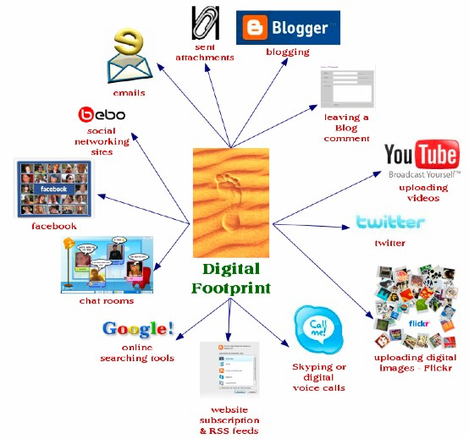

Slide 6
It all starts with Google…
Someone needs a lawyer – they do a keyword search
You send an email with your name and website information
Your are referenced in a news story or press release
You receive an online recommendation
Your firm runs an ad with your name in it
You have multiple online professional listings

Slide 7
What Google says matters!
What will potential clients, referral sources and others find in a Google search of your name?
How do you show up and what can you do to control the information that is out there?
Notes:
Do you have a consistent image across all owned media?
It’s important to have a consistent image across all owned media. Owned media is your website, online professional profiles, blogs, firm generated press releases etc.
Is your website or blog informative and helpful to potential clients?
Are you really social on social media – this speaks to your level of engagement
Is your LinkedIn profile and company page opitmized and consistent with other professional profiles

Slide 8
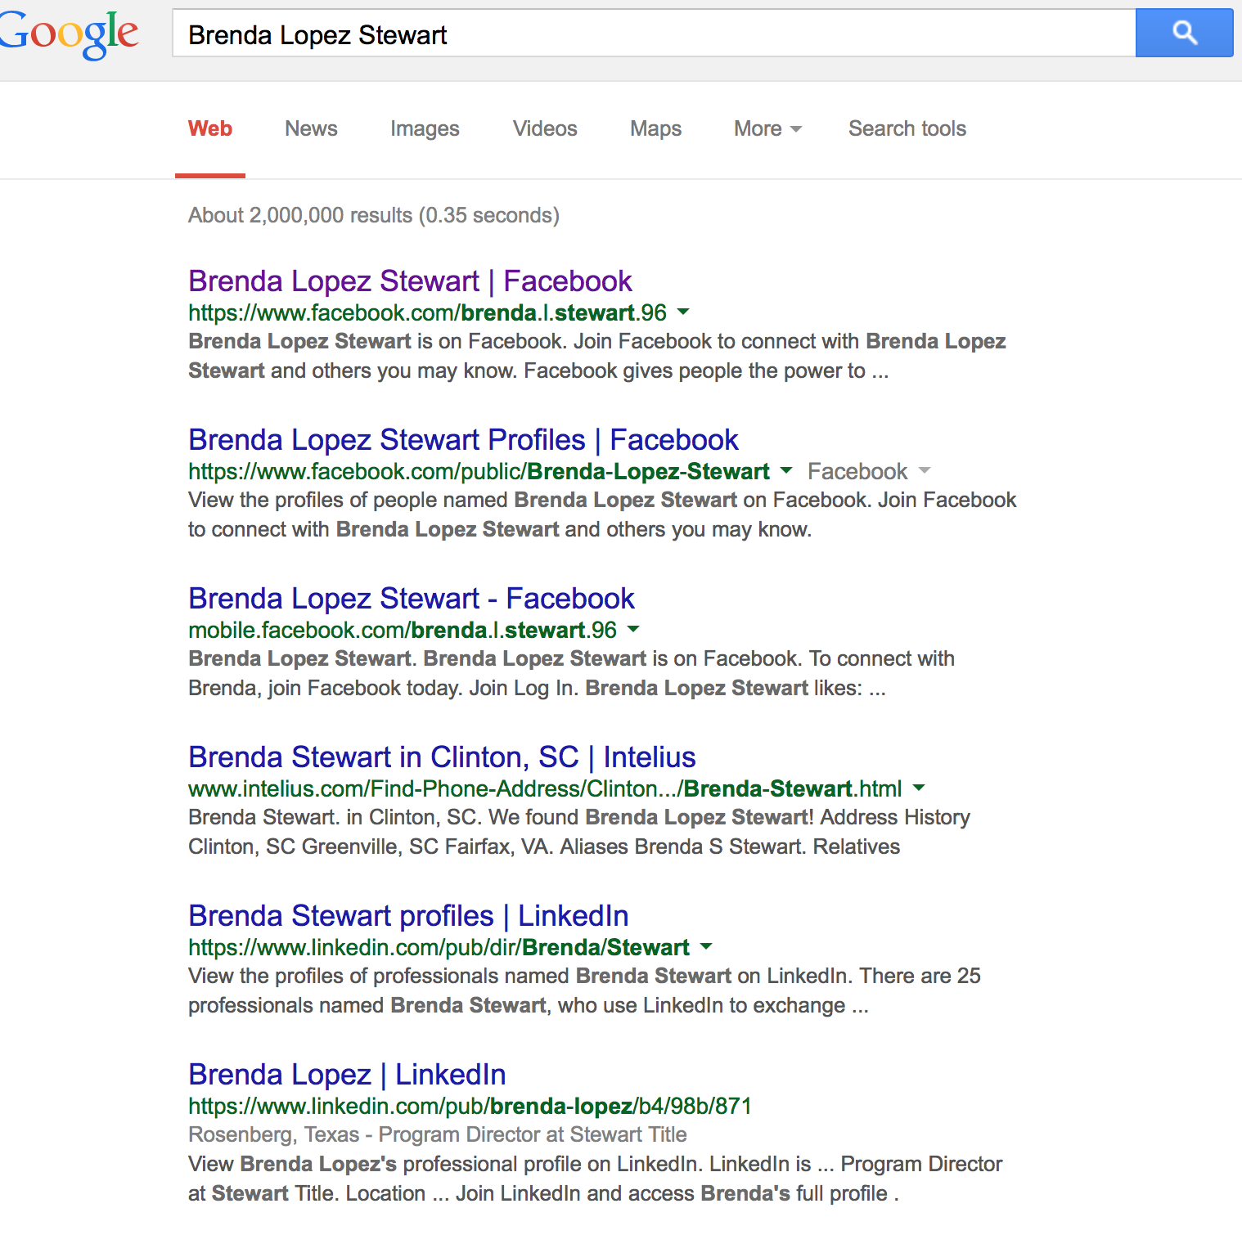
Google Yourself – what shows up?

Slide 9
What is your brand?
Your reputation - how others perceive you as a lawyer and your firm
Your managed reputation - how you want others to see you and your firm

Slide 10
The role of SEO and SMO

Slide 11
How do you strengthen your digital footprint?
SEO – optimize search results for your name and your firm
SMO - optimize use of social media – your website and online networking profiles to increase brand awareness

Slide 12
Search Engine Optimization
On your website, blog and professional networking profiles use keywords that are important for others to find you on Google
Let Google help you
find keywords

Slide 13
Google searches…

Slide 14
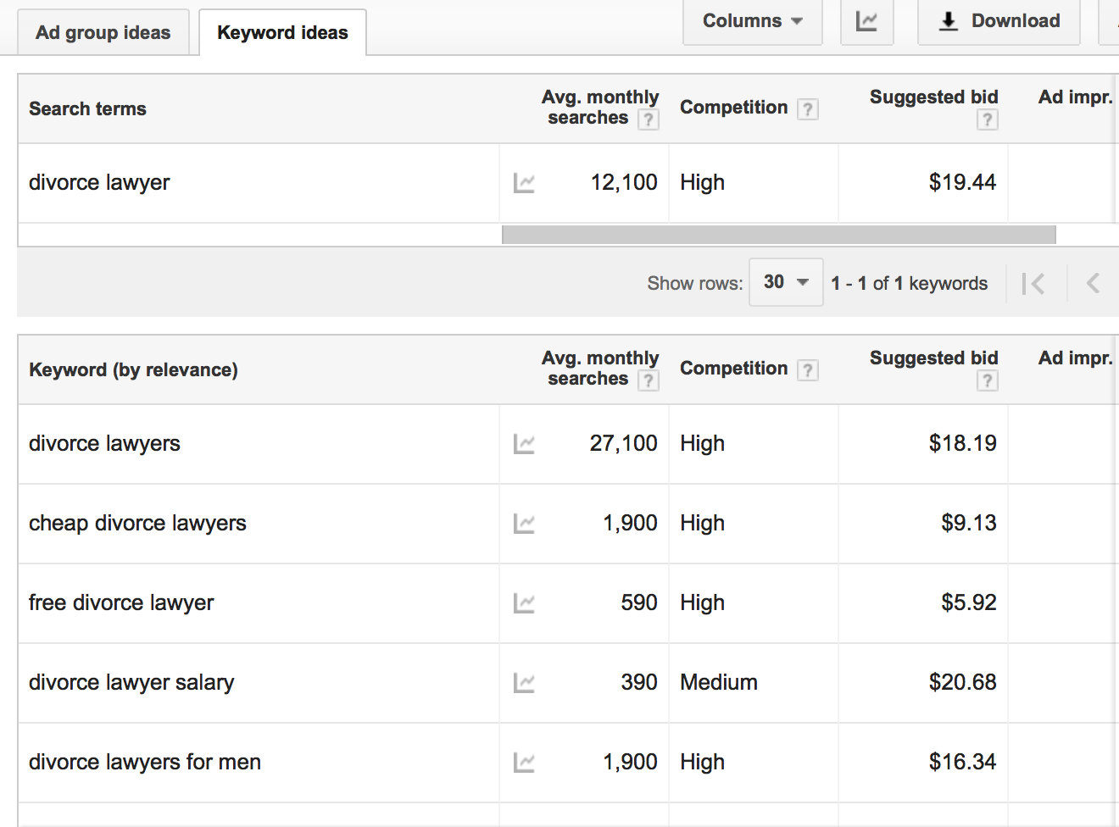
Finding Keywords
https://adwords.google.com/keywordplanner
Notes:
Https://adwords.google.com/keywordplanner

Slide 15
Social Media Optimization
Where do you show up online and in social media?
Website/blog
LinkedIn
Twitter
Facebook
YouTube Channel
Google+ Page

Slide 16
Social Media Optimization
Share updates on various platforms to amplify presence
Include external linking on website and professional profiles to increase relevance and ranking
Include website and LinkedIn profile vanity link in email signature block

Slide 17
Online Reviews – Do they matter?

Slide 18
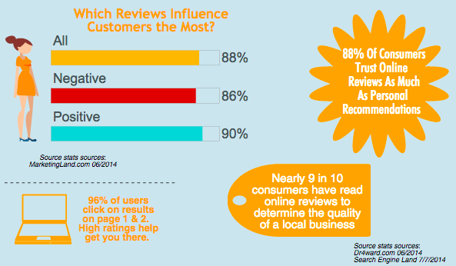
Yes reviews matter!

Slide 19
Cultivate Positive Reviews
LinkedIn – ask for recommendations
Review content posted by others on your profiles (AVVO)

Slide 20
Tips for polishing your
digital footprint

Slide 21
Quick Tips
Google Yourself
What do you see – this is what others see.
Set up a Google Alert for your name

Slide 22
Quick Tips
2. A picture is worth 1,000 words
Use a current professional photo on all professional websites and networking platforms

Slide 23
Quick Tips
3. Connect Your Social Media Sites
LinkedIn, Twitter, Facebook
Easier for readers to view your information on different platforms

Slide 24
Quick Tips
Ask for Recommendations
Remember what others say about your service matters
Be selective in your requests
Post recommendations on different social media platforms

Slide 25
Quick Tips
5. Actively participate
Share firm news on multiple platforms
Provide commentary in discussion groups
Post industry related content

Slide 26
Quick Tips
6. Continue to build your bio
Keep information current on all platforms
Add superlative rankings, areas of practice, community involvement
Demonstrate your depth of experience in various practice areas
Show a progression of growth and advancement

Slide 27
Quick Tips
7. Update your listings
Google, Bing, Yahoo, Google +
Local online directories
YP.com
Bing Local
Citysearch.com

Slide 28
Quick Tips
Legal directory profiles (AVVO, Martindale, Best Lawyers, Super Lawyers, Primerus, etc.)
Keep a master list of all online profiles
Make sure profiles are complete
Review them regularly
Keep them current

Slide 29
Quick Tips
NAP = Business Identity
Make sure your Name, Address and Phone number are correct on all sites and platforms
Have you moved your office or changed your number?
Discrepancies will impact your ranking in searches

Slide 31
And in this digital age…
Your brand is also what Google says about you!
So what does your digital footprint look like?

Slide 32
Questions

Slide 33
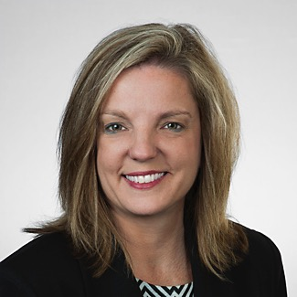
Brenda Stewart
Stewart Marketing & Consulting
Brenda@StewartMarketingandConsulting.com
864-449-7700

