Slide 1
Social Media
Get Out of Your Comfort Zone

Slide 2
I’m a lawyer.
Why should I care about social media?

Slide 3
Lawyers with whom I have personally worked have received direct new business from online professional networking.
BUT - Simply signing up for these tools will not generate new business.

Slide 4
What is Social Media?
Social Media is the interaction among people in which they create, share or exchange information and ideas in virtual communities and networks.

Slide 5
Social vs. Professional Networking
Social networking is sharing with family and friends online for fun – it’s personal.
Online professional networking helps professionals find each other, interact, collaborate and share information.

Slide 6
Online Professional Networks
LinkedIn (www.linkedin.com) - all types of professionals
Martindale-Hubbell Connected (www.martindale.com) - Lawyer network
Sermo (www.sermo.com) - Physician network

Slide 7
Primary Professional Networking Activities
Build – connections and advance relationships
Listen – Alerts, blogs, newsfeeds, scans
Collaborate – join groups, connect, comment, blog, create and participate in online discussions
Promote – yourself and your firm - enhance profile, create blogs, podcasts, videos, and more

Slide 8
How to use Social Media?
Keep informed
Client attraction
Personal and company
branding
Attracting staff
Getting referrals from other
professionals
Keeping up with competition
Clients will research you
Employment opportunities

Slide 9
Keeping Informed
Set up a news feed for Google alerts
Follow hashtags on twitter
Subscribe to industry blogs
Follow LinkedIn “Pulse”
Join LinkedIn Groups

Slide 10
The Business Case

Slide 11
2013 In-House Counsel Survey
Legal Industry survey published April 2013
Sponsored by Greentarget, InsideCounsel, and the Zeughauser Group
379 Respondents
GCs
Chief Legal Officers
Deputy/Asst GCs
In-House Counsel
Other related titles

Slide 12
2013 In-House Counsel Survey
67% of in-house counsel have used LinkedIn in the past week for professional reasons
Overall social media usage has increased to 73% across the board – a 16% rise since 2010
Mobile usage is up – content is being read on both smartphones and tablets
Over 60% use LinkedIn for industry news
60% use LinkedIn to stay in touch with outside counsel

Slide 13
Ethics, Guidelines and Best Practices

Slide 14
Ethics, Guidelines and Best Practices
Be Transparent and clear in identity and intention
Adhere to ethical rules and guidelines
YOYOW – You Own Your Own Words
Be responsible and trustworthy
Finish what you start
Value and create thought leadership

Slide 15
Relevant Rules
CONFIDENTIALITY
CONFLICT OF INTEREST
ADVERTISING RULES
PROFILES AND POSTS ARE SUBJECT TO THE ADVERTISING RULES
SOLICITATION
PROFESSIONALISM AND CIVILITY
NON-LAWYER STAFF SUPERVISION

Slide 16
Overview of Social Media

Slide 17
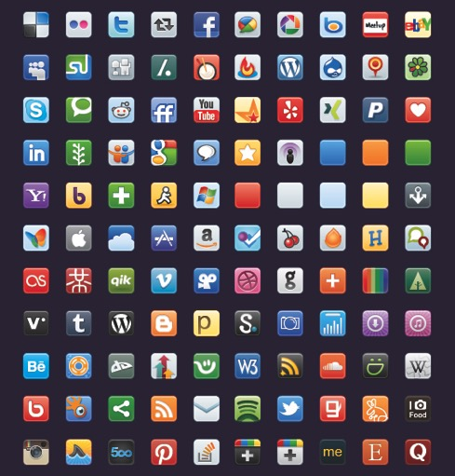
Which ones to use?
Photo courtesy of underworldmagazines.com
Notes:
This is a snapshot of the social media landscape. Today I’m only encouraging you to consider two platforms – LinkedIn and Twitter.

Slide 18
LinkedIn

Slide 19
Introduction to LinkedIn
The Professional Social Network
By the Numbers
2
350 Million
107 Million
41%
200
8,000
17 minutes
Notes:
LinkedIn is The Professional Social Network, and it’s “hot”
http://expandedramblings.com/index.php/by-the-numbers-a-few-important-linkedin-stats/
There are 2 new users of LinkedIn each second
300 Million Users as of 5/1/14
100 Million LinkedIn users in the US
Percentage of LinkedIn visits from a mobile device 41%
Conversations per minute occurring in LinkedIn Groups: 200
8,000 new groups per week
Average time a user spends on LinkedIn monthly 17 minutes
% of LI users who check it daily – 40% as of 7/2013
And of particular interest to attorneys:

Slide 20
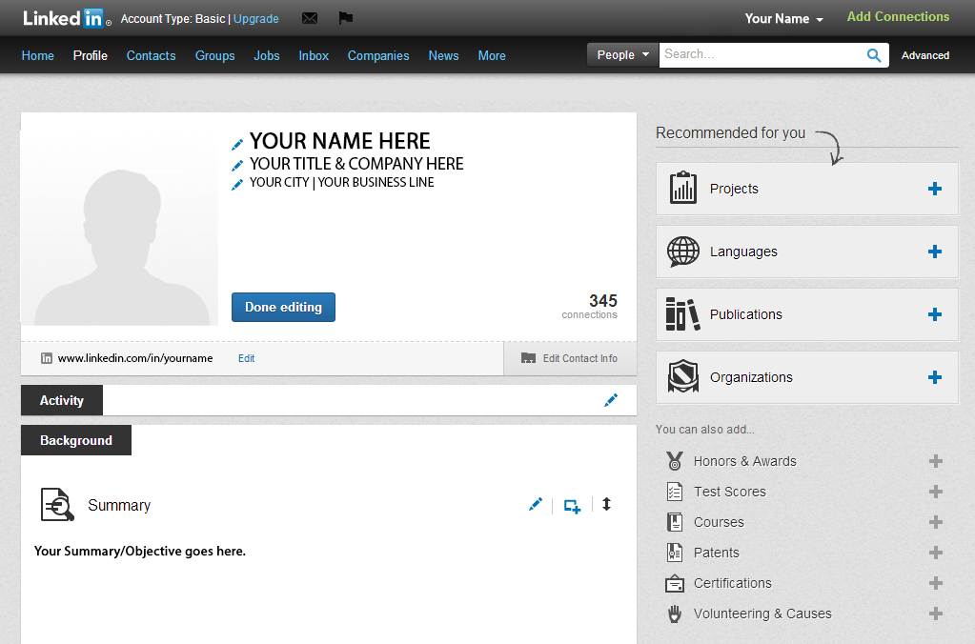
Your Profile

Slide 21
A strong profile is key!
Peer referral is the strongest source for recommendations, referrals, and new business relationships
Online profiles are today’s virtual business card
Your profile forms the basis for connecting with others

Slide 22
Photo or No Photo?
Use a professional photo.
Make sure someone that knows you can recognize you from the photo.

Slide 23
Essential Sections
Top of profile – name, title and contact informaton
Summary
What are you about? Keep it concise.
Experience
Format as narrative with bullet points to break up content.
Skills
Be strategic in the skill sets you list
Education
Add clubs and affiliations
Organizations
Bar memberships, Professional memberships, etc.
Certifications
Notes:
Narrative – human nature and storytelling

Slide 24
Titles

Slide 25
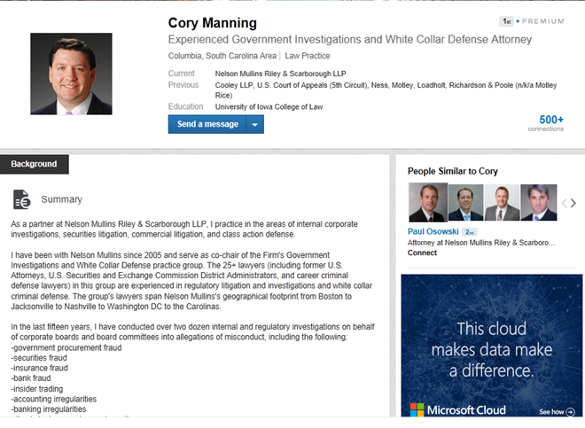

Slide 26
Writing for search optimization
The key to a powerful, searchable profile is keywords. These can be industry or practice area specific, i.e. mergers and acquisitions, consumer credit,
Use in the Summary and Experience sections.

Slide 27
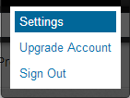
Basic Settings
Your basic LinkedIn settings are, by default, set up to make you very networkable, informed, and connected to your network.
Most settings will depend on your personal level of connectivity and preferences.
You can access your settings by clicking the down arrow next to your name at the top right of the header bar, and choosing “Settings” from the menu.

Slide 28
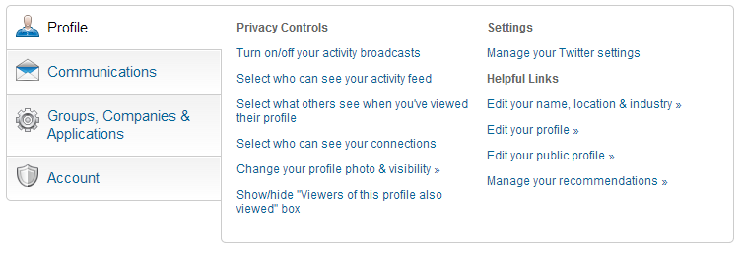
Basic settings
From the settings screen, you can manage your entire profile, email preferences, privacy, and account levels.

Slide 29
Privacy Settings
The privacy settings are very important on LinkedIn, and can be used to control who sees what about you.
Use these settings to limit your profile visibility, contact info, and how you show up on other people’s “who viewed my profile” list.

Slide 30
Activity broadcasts
The first privacy setting is whether you want your activity on LinkedIn to show up on your profile, and who can see it
If you “like” or comment on an article, update your skills, change your photo, it will show up in you “Activity” Section of your profile – this can be changed here

Slide 31
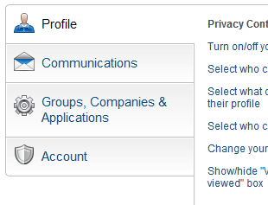
Anonymity
You can control how you show up for others when you view their profile
This setting is particularly important if you’re researching a client/matter/etc.
Click this to see the 3 options for how you will appear to a person whose profile you have viewed

Slide 32
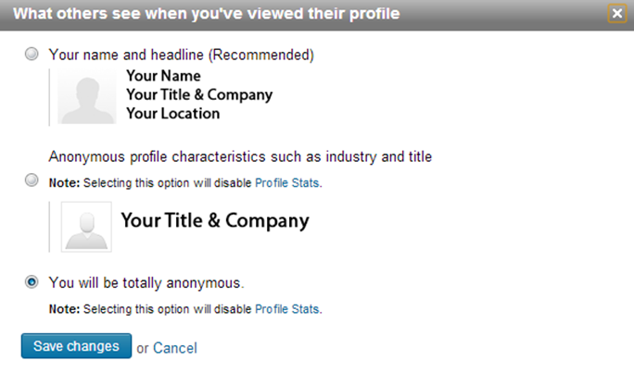
Anonymity
You can select “totally anonymous” as your privacy setting, but it limits the intelligence you will be able to gather from who has viewed your profile.

Slide 33
Communications Settings
You can control how you are messaged about activities on LinkedIn, who can email you, and if you want to opt-in to marketing messages, etc.

Slide 34
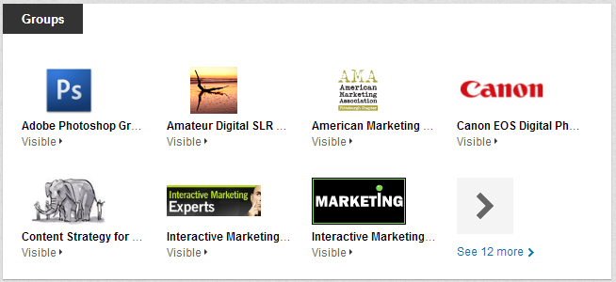
Groups
Groups are a major part of LinkedIn’s networking
Participation is optional, but can be a big boost for your profile

Slide 35
Why join Groups?
Joining industry and interest specific groups is a great way to network and grow your personal brand and establish thought leadership
Many groups have active discussions, and are a fantastic resource for getting connected with the right people and products
Groups can be public or private/invite-only
Groups enrich the results of your searches, as well as increasing the visibility of your own profile for other people’s searches

Slide 36
What groups should you join?
Join a few groups to start, such as:
Industry related groups
Alumni associations
Specific topics
Related interests

Slide 37
Online Discussions and Groups
Discussion
Engage wide audience on topic or issue
Open to all community members
Some discussions are transactional – “how do I” and others more reflective
Groups
More private and specific topics
Often closed to group members only
Make contributions and add value or maybe not the right group for you

Slide 38
Following
LinkedIn also offers the ability to follow companies and people
When you follow, you are “opting-in” to receive updates in your news feed
This is a good way to stay on top of industry news, competitors, current or prospective clients, etc

Slide 39
Why post updates?
Posting updates keeps you in your network’s news feed
The more you share, the more your influence and network will grow
Sharing firm content helps extend the brand’s reach
Sharing content can lead to discussions that lead to opportunities
Notes:
What should you post?
Insightful industry news – updates on changes to the closing process, your firm’s ability to comply with the changes
Firm announcments
Links to articles
When to post – best times are Tuesday-Thursday from 11 am to 4 pm

Slide 40
LinkedIn Profile tips
Never post any company or client confidential content of any kind
If researching for a matter, it’s best to set your appearance to “anonymous”
Don’t accept every connection request, unless you are familiar with the person
A good general rule is to have some other form of contact with them, whether email, phone, or in person
But at the same time, don’t be afraid to reach out to make a connection, and then follow up offline
Stay active on LinkedIn
Comment, like, post – stay in your network’s news feed to build your brand as a thought leader
Share a mix of industry content, news, and firm content

Slide 41
What can you do?
Keep your profile up-to-date
Customize for maximum searchability
Always add content you author
Monitor your profile views for possible new connections
Personalize connection invites for greater impact

Slide 42
Leverage your network
When you author content, post a link on your profile
This makes it easy for your network to share it with their connections
Written recommendations are great for your personal brand and the firm’s brand
Pay attention to who people in your network are interacting with
If your practice has client targets, utilize your network to secure introductions to individuals in that organization
You could find a new connection opportunity through a shared contact or referral
Notes:
Recommendations – SC Rules?

Slide 43
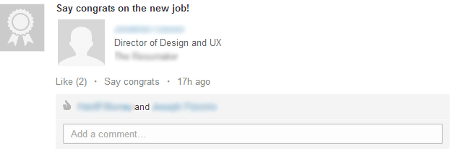
Leverage your network
Watch for job changes in your network
When a connection has a new job or title/promotion, it can mean opportunities for new business
Take these opportunities to reach out with a congratulatory note or set up an in-person meeting

Slide 44
Leverage your network
Also pay attention to who select people in your network connect with
When one of your contacts has a new connection, it could be a good opportunity for an introduction

Slide 45
Share more content
Consider sharing firm-posted content with your network
If the firm has major news, such as a prestigious industry award or the launching of a new location, share it!
If you are attending a noteworthy event for your practice, you can share some of the highlights of the event
If there is an upcoming firm event in your office that is open, you can mention the event and its significance
If you read a highly relevant industry blog, article, etc. - share a link!
The key is to share timely, valuable content that your network can find useful
Be careful not to overshare - everything is not worthy or relevant to your network

Slide 46
Customizing your profile
LinkedIn profiles are very flexible, and allow for all kinds of content to be added, such as
Your blog
Your Twitter feed
Link to Practice Group
Organizations, associations, etc.
Multi-lingual content
Be sure to list other languages
Add some content in other languages, such as skills and keywords

Slide 47
LinkedIn – Building Your Network

Slide 48
Linking = implied trust
Knowledge
Implied Trust
Social
Notes:
Don’t link with those you don’t know. By linking with someone you are saying “I know this person; he or she is in my life,” and you don’t want to be associated with anyone you don’t actually know.
Talk about Hummingbird, venn diagram, new search algorithm
Help with Google results- your public profile information will be in Google results, so if you are ever in the media, or representing someone who is in the media, you can be sure the reporter will pick up info from your LinkedIn profile.

Slide 49
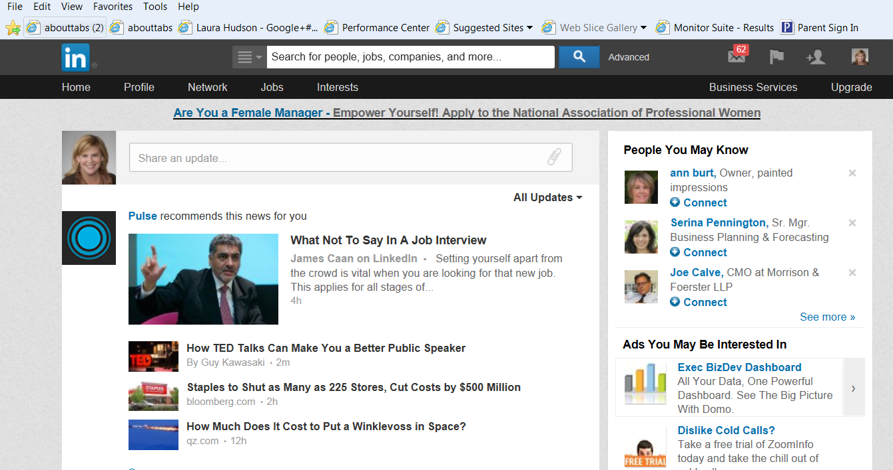
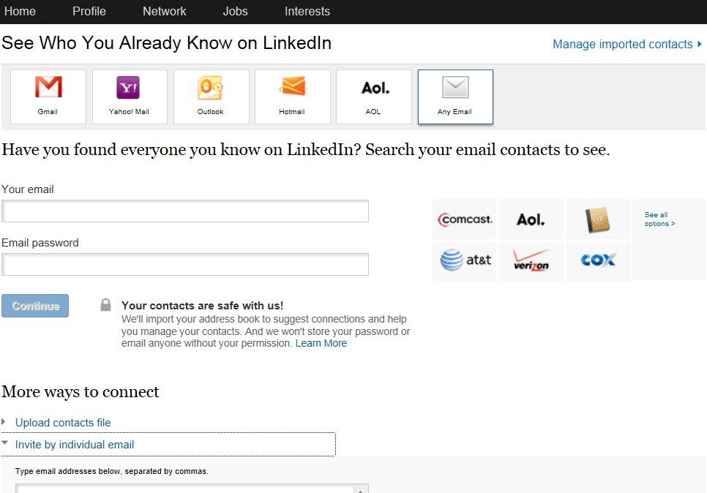
Finding your connections
Searching and teaching Linkedin
Notes:
You may synch your email or upload a contacts file to see who you know on LinkedIn.
You can also search individual’s names.
Laura can tell about the Lost Banker’s initiative

Slide 50
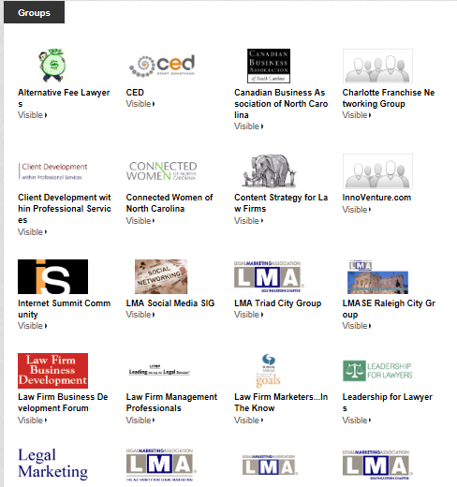
LinkedIn Groups Go where your market is!
Notes:
We are judged by the company we keep, and so it is with LinkedIn groups. Just like the people we link with imply trust and credibility, the groups we join and show on our profile lead people to make assumptions about us.
Join groups that are important to your clients.

Slide 51
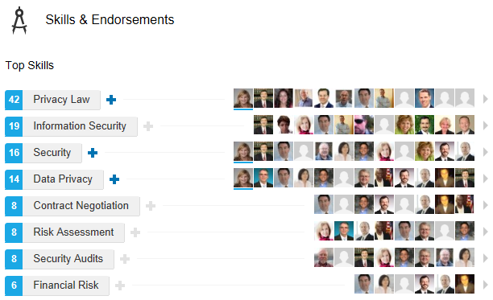
Skills and Endorsements

Slide 52
The Power of Recommendations

Slide 53
Twitter

Slide 54
What is twitter?
“A real-time, micro-blogging, conversational, breaking news, 140-character message, hashtagging, event-tracking Social Networking site.” – Nancy Myrland, Myrland Marketing

Slide 55
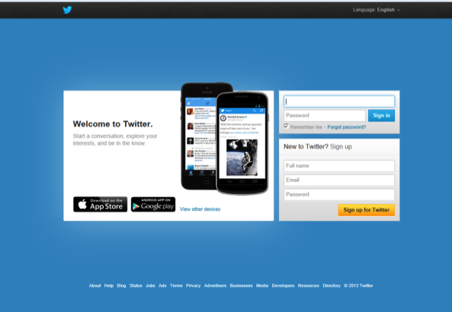
Getting started
Sign up for a free account.

Slide 56
Getting started
Use your real name or some abbreviation of it as your “handle.”
Use your real photograph instead of an “avatar.”
Write a catchy bio.
LISTEN first. Follow a few people and skim your stream once or twice a day.
Notes:
Transparency is key in building and maintaining a strong reputation and strong relationships, so I recommend:

Slide 57
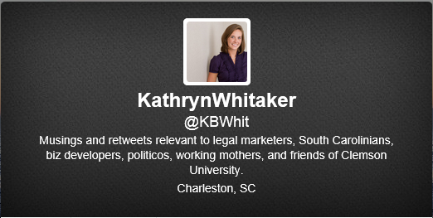
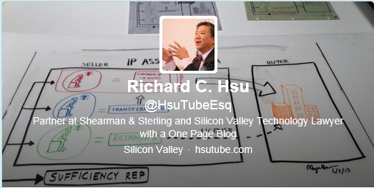
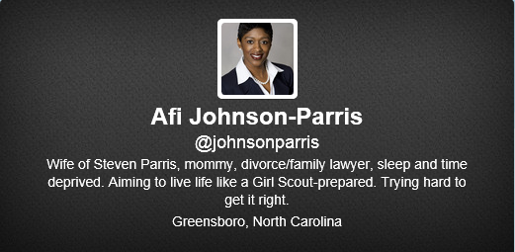
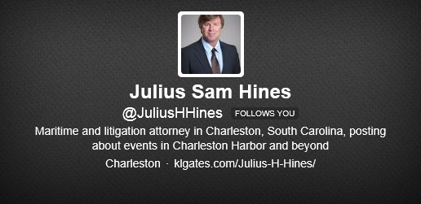
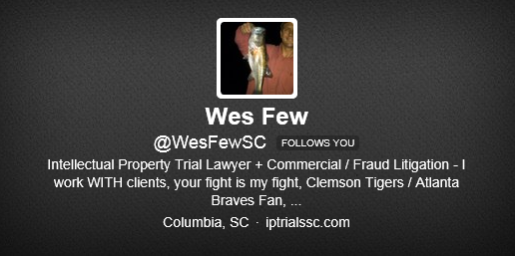

Slide 58
Posting content
140 characters or less
Shorten URL
Choose a focus and become an authority.
What you share should be interesting and engaging.
It should not be your content only. Share others content and engage in conversations.
Don’t be afraid to share occasional personal interest; it gives you personality and makes you approachable.

Slide 59
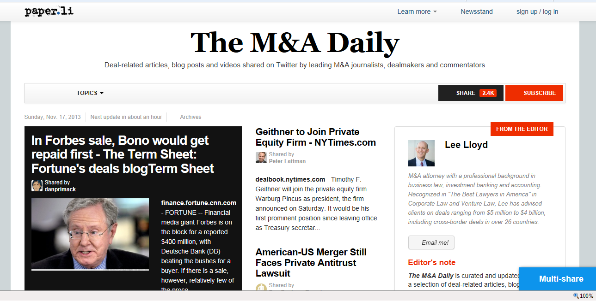
Paper.li
Tool within Twitter to automatically curate a “newspaper” about a specific topic.

Slide 60
Facebook

Slide 61
Facebook
Business to Consumer
People catching up on their world
Works well for a plaintiff practice
Used by firms to demonstrate community involvement
Repurposing of press releases and announcements

Slide 62
Tools for Managing Your Social Media

Slide 63
Hootsuite
Free for up to five platforms.
Allows for
Simultaneous send to multiple platforms
Scheduling messages
Tracking

Slide 64
JD Supra
Cost depends entirely on amount of content produced.
Scrolls website or blog site for content you publish and automatically pushes through your social media channels.

Slide 65
Getting Started with Social Media
Start slow or fail fast
Have a strategy
One network at a time
Execute tactics
Test, measure, modify or abandon

Slide 66
Measuring ROI How to value your social media activity
What is your LinkedIn reach?
How engaged are you in your LinkedIn groups?
Are you increasing your thought leadership with posts on all platforms?
Are you driving connections to your website?
Have you received new business opportunities through LinkedIn, Twitter or Facebook?

Slide 67
Questions

Slide 68
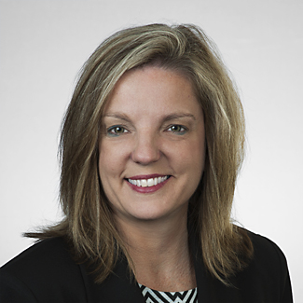
Brenda Stewart
Stewart Marketing & Consulting
Brenda@StewartMarketingandConsulting.com
864-449-7700

