Slide 2
Ethical & Effective Business Development: The Value of a Good Story
Tea Hoffmann, Esq.

Slide 3
Agenda
Marketing vs. business development
4 rules for a good story
Telling your personal/firm story
Ethical guidelines
Steps to creating your personal/firm story

Slide 4
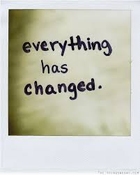
Just to be clear…

Slide 5
The good news & the bad news
Nothing has really changed…ever!
Do really good work
Treat people well
Know the law
Get involved in the community
Join the right clubs, religious entities, community/civic boards
Gain credibility/visibility in an area that you like and/or where you can make the most money
Everything has changed! And it is NOT over!
Glut of attorneys on the market
Client demands on price versus value/quality
Internet
Social media
Advertising
Expertise building
Personalities/status

Slide 6
What is Marketing?
Identifying your key differentiators
Developing your message and
establishing your position within
your market
Examples:
advertising
event promotion
website content and building
public relations

Slide 7
What is Business Development?
Targeted networking
Building your brand through targeted marketing efforts
Prospecting (think networking events)
Qualifying opportunities and then converting those into clients
Business development is all about creating relationships.

Slide 10
Elements of storytelling
Good stories start conversations
Great stories connect emotionally
Your story is not all about you
Always be ready to tell your story
http://buzzadelic.com/4-storytelling-fundamentals-for-smart-marketers/

Slide 11
Start conversations
Notes:
Smart marketers are cutting through the noise by starting conversations that matter to their customers. As we make real and meaningful connections through common interests, we’ll be creating touch points that lead to trust and affinity, putting you top-of-mind when a consumer has a need.

Slide 12
IPWatchdog.com is the leading Intellectual Property Law Blog on the Internet
One of the top 100 legal blogs by the American Bar Association for 5 years in a row
In January 2014, it was inducted into the ABA Blawg Hall of Fame
The founder, Gene Quinn, is a patent attorney, law professor, and leading commentator on patent law and practices patent law with Widerman & Malek

Slide 13
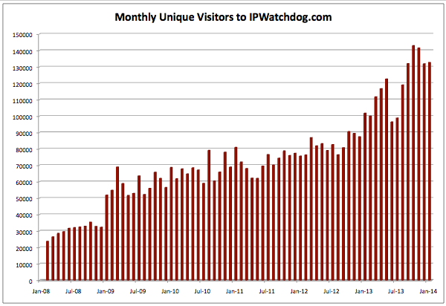

Slide 14
Business development conversation starters

Slide 15
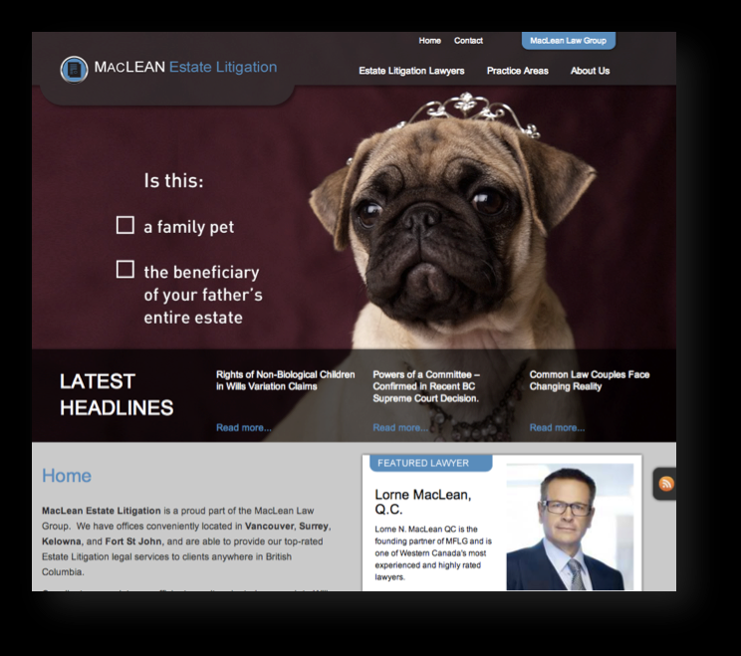
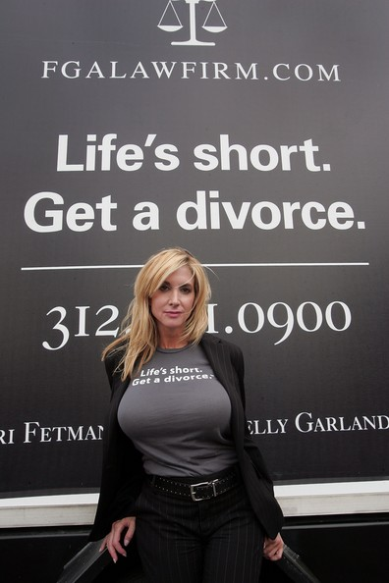
Connecting emotionally

Slide 16
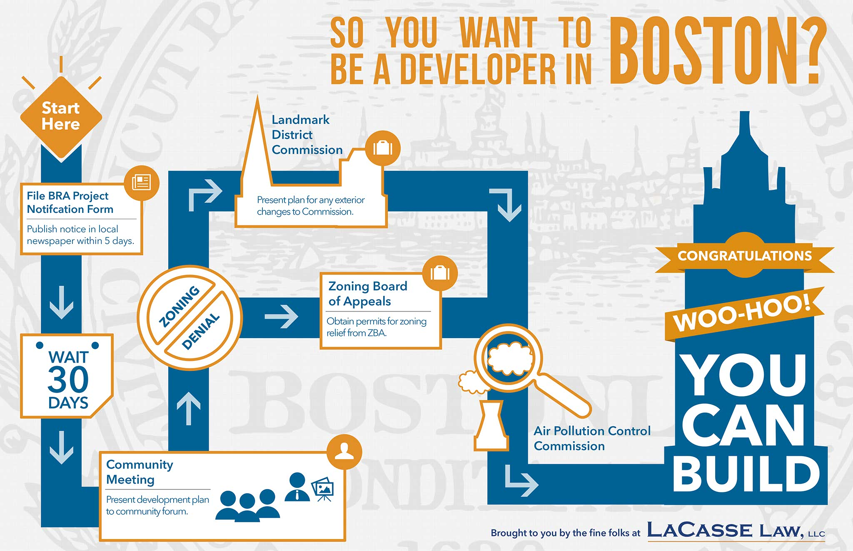

Slide 18
It’s not all about you!
Michael Anthony Rossi
Michael Anthony Rossi is a tough, aggressive Civil and Criminal Trial Attorney who has handled serious personal injury, DWI and criminal defense, and divorce, custody and support matters throughout western New York for over 31 years. He insists on providing you with the personal attention you need and deserve during these emotional and uncertain times.
Michael understands the stress and concerns you face when legal issues arise. He can and will help you address questions regarding your case. He will provide aggressive representation when necessary and a cost-effective, and less adversarial alternative, if the situation calls for it.
At the Rossi Law Firm our goal is to answer your questions, provide you with sound advice, provide you with available options, protect your rights and interests, and help you solve your legal problems. We believe that each client deserves a personalized and rapid solution to his or her legal matter.
http://www.rossilawfirm.com/about_us.php
Notes:
11 you’s

Slide 19
KEVIN J. PALMERSHEIM
Shareholder / Managing Attorney
Kevin Palmersheim is a founding shareholder of the firm as well as its managing attorney. In addition to the knowledge and experience that Kevin brings to legal issues as a highly-experienced business attorney, he is also adept at being creative and flexible in representing clients' interests both in court and in negotiations. He excels at finding cost-effective strategies to resolve business disputes and execute complex transactions. In his work as a business attorney, Kevin routinely represents clients on a variety of business litigation matters and advises on a broad range of business transactions, such as contracts or clients buying and selling businesses. Kevin also acts as outside general counsel for a number of Wisconsin businesses.
http://www.hplawoffice.com/attorneys/kevin-palmersheim/
Notes:
7 he, his, Kevin

Slide 20
Telling your story
http://www.icardmerrill.com/
http://www.sw.com/
Bigger is good. Smarter is better.™

Slide 21
The ABA rules
Rule 3.6 Trial Publicity
Rule 4.2 Communication with Person Represented by Counsel
Rule 4.3 Dealing with Unrepresented Person
Rule 7.1 Communication Concerning a Lawyer's Services
Rule 7.2 Advertising
Rule 7.3 Direct Contact with Prospective Clients
Rule 7.4 Communication of Fields of Practice and Specialization
Rule 7.5 Firm Names and Letterhead
Rule 8.5 Disciplinary Authority; Choice of Law

Slide 22
Compliance tips
Establish policies and procedures for all external marketing communication
Adhere to rules of all states where you do business or seek clients
Keep records / copies and submit to applicable compliance organization before publishing if required
Steer clear of testimonials unless you have the client’s written consent
Avoid subjectivity
Incorporate all necessary language
Use disclaimers

Slide 23
Avoid…
Overtly soliciting business
Giving legal advice through advertising/marketing efforts
Using subjective language when referring to attorney or firm
Creating unjustified expectations
Comparing attorneys or firms
Talking about pending cases (material prejudice)
Ignoring your state’s rules of conduct or multi-jurisdictional considerations

Slide 24
Authenticity
The foundation of your story rests on authenticity: The ability to tap into your genuine, humble, and individual human qualities from which your identity, personality, and character stem. – Neal Patel

Slide 25
Steps to building your personal/firm story
Determine your unique value proposition
Find out how others see you
Identify your goals
Identify your target audience
Pay attention to the details
Update everything to reflect your newly discovered brand
http://www.salary.com/sell-yourself-14-steps-to-creating-a-powerful-personal-brand/slide/15/
Become a social networker
Build your website around your brand
Blog
Get published
Go offline
Tend to your marketing network
Review your story (and how you portray it) frequently
Notes:
Step 1: Determine your unique value proposition
Spend some time thinking about what makes you different than your peers -- your strengths, your passions, and your goals.
If you left your job today, what would your company and colleagues miss? Know who you are, as well as who you are not.
Ask trusted colleagues, co-workers, and friends for four or five adjectives they would use to describe you.
What are you good at? What are your strengths? In which areas do they view you as "irreplaceable?“
Where would you like to be in six months? One year? Five years? Ten years?
Just like Starbucks knows that their target audience is coffee drinkers, you need to define to whom you want to send your message.
This will not only help you hone your message, it will help you deliver it to the right places.
Defining your goals is necessary to crafting a message that helps you reach them.
Everything you do ultimately contributes to your personal brand.
Once your brand has been defined, make sure that the little things -- the way you dress, your body language, how you behave with co-workers, the emails you write -- are consistent with your brand message.
Be sure to promote your brand in person, too.
Join and participate in industry groups, give talks at conferences, or offer to spearhead a large project that highlights your unique talents.
Be sure to keep co-workers, colleagues, clients, and friends updated about what you are doing.
Word of mouth is a powerful marketing tool, and what the people in your network say about you will ultimately have an effect on your brand.

Slide 26
Targeting
Marketing
Business Development
Where should you focus your marketing efforts?
What marketing devices will your clients/prospects be most likely to “see”?
What consistent message do you want your clients/prospects to remember?
How will you measure the impact of your marketing efforts?
What events should you attend?
What events should you sponsor/host?
What will be your consistent, memorable and authentic pitch?
Where should you focus your external efforts (speaking, publishing, blogging)?
How will you measure the impact of your business development efforts?

Slide 27
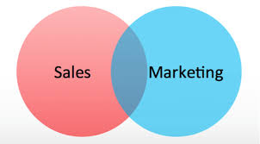

Slide 28
For more information on how to refine your efforts and add to your bottom line, please give me a call!
Thank you for your time and attention.
Tea Hoffmann, Esq.
Law Strategy Corp.
615-330-5129
teahoffmann@lawstrategycorp.com

