Slide 1
MENTORING AND DELEGATION
MAKING CAREERS AND MAKING MONEY

Slide 2
Jack Downton
Managing Director, The Influence Business

Slide 3
ACE Model
Client Relationship Skills

Slide 4
ACE Model
Client Relationship Skills

Slide 5
TRUST
AUTHENTIC ACTION

Slide 6
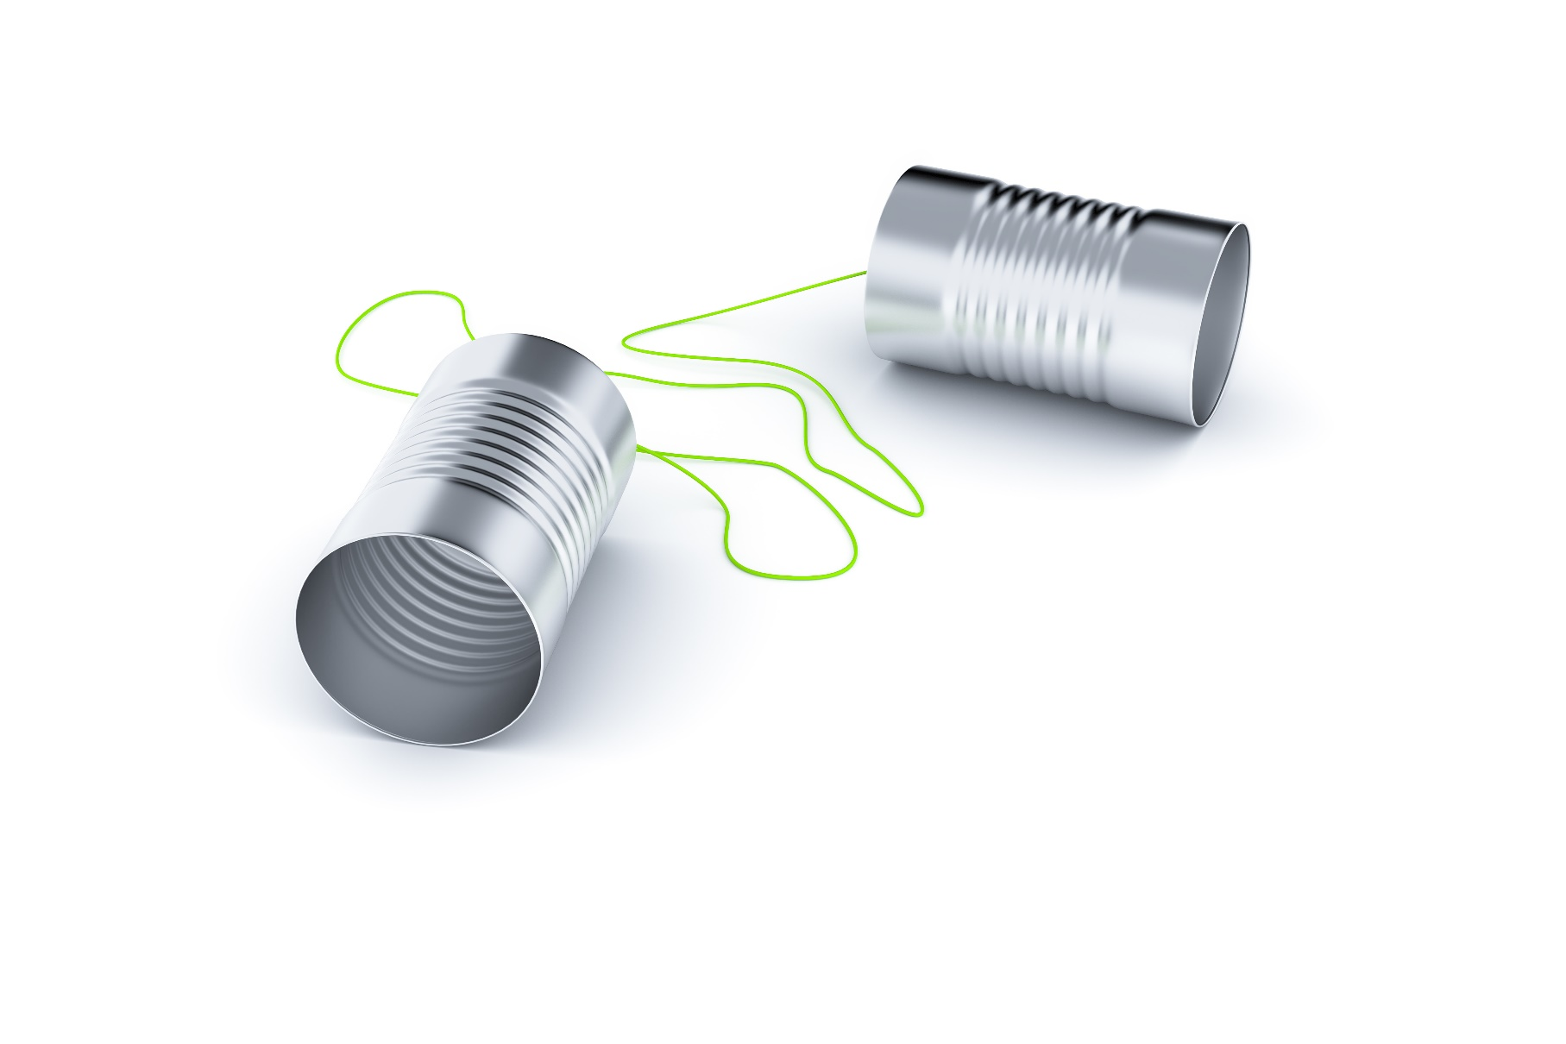
TRUST
COMPLETE COMMUNICATION

Slide 7
TRUST
EMOTIONAL ENGAGEMENT

